Slide 1

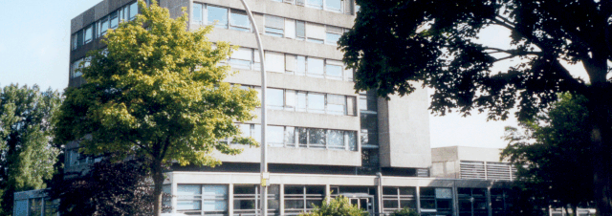
Simulation of production process-related adhesive damage of adhesively bonded multi-material body in white
Suba Siva Chandran, Kalimuthu, 28.05.2020

Slide 2
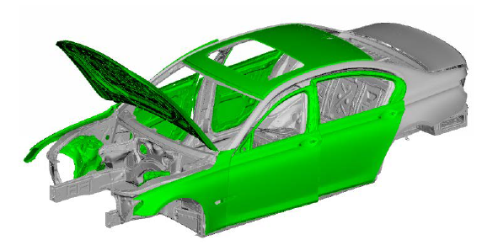
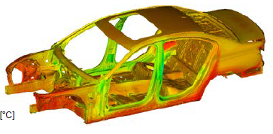
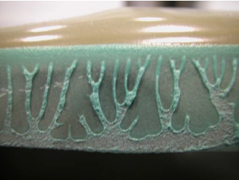
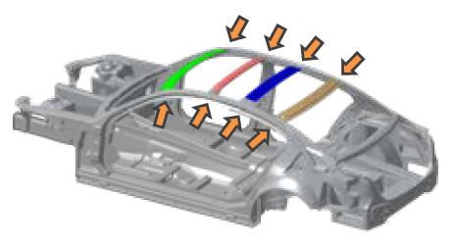
Contents
Introduction
Industrial process and problem description
Motivation and objective
Overview of material properties
Workflow of the simulation
Results
Conclusion and future work

Slide 3
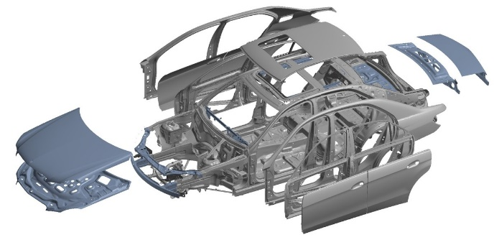
Introduction
What is a multi material BIW?
Stage in manufacturing process
Components joined together
27% of a car’s curb weight
Lightweight materials in a BIW
Advantages
Increases fuel economy
Reduces overall weight
Can be safer
Improves handling of the car
Multi-material BIW [1]

Slide 4
Contents
Introduction
Industrial process and problem description
Motivation and objective
Overview of material properties
Workflow of the simulation
Results
Conclusion and future work

Slide 5
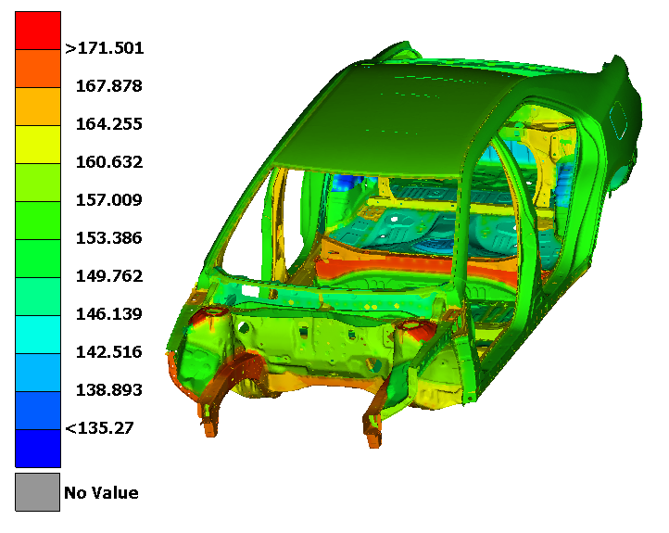
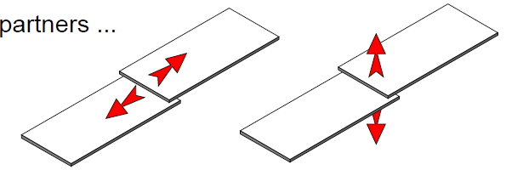
Industrial process and problem description
Pressing
Assembling
Paint pre-treatment
Final curing
Cathodic dip paint oven
185°C
15 mins(approx.)
Cathodic dip painting
Relative displacements [3]
Overview of the industrial process [2]

Slide 6
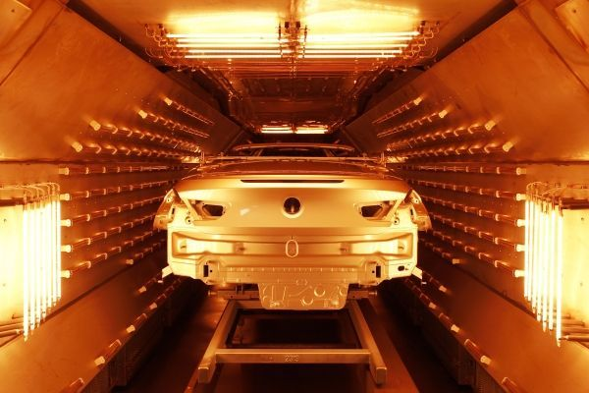
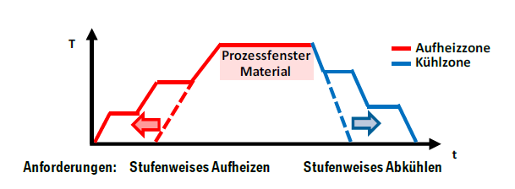
Industrial process
Freshly painted car body positioned in paint-drying oven for curing [4]
Schematic representation of the temperature curve in a multi-material dryer process [2]
Heated to 185°C and cooled down to room temperature
Several zones connected in series with different temperatures
Homogenous heating must be ensured in mixed construction bodies
Step shaped heating and same applies to cooling profile

Slide 7
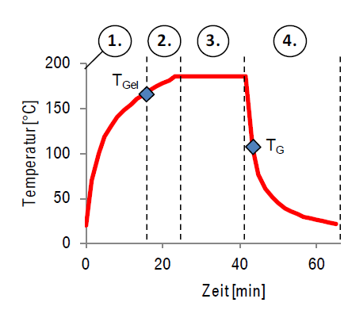
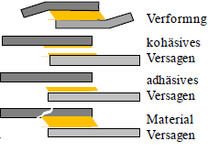
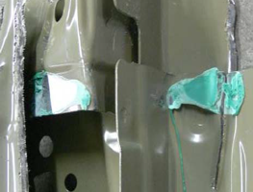
Problem description
Delta Alpha problem
Relative displacements in flanges due to different expansion coefficients
It describes the resulting mechanical stress on bonded joint and joining partner
Adhesive failures
1
2
Heating phase
3
Holding phase
4
Cooling phase
Adhesive fracture [3]
Adhesive crack [3]
Temperature curve CDP dryer with resulting relative shift in the adhesive flange during the heating and cooling zone [2]

Slide 8
Contents
Introduction
Industrial process and problem description
Motivation and objective
Overview of material properties
Workflow of the simulation
Results
Conclusion and future work

Slide 9
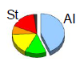
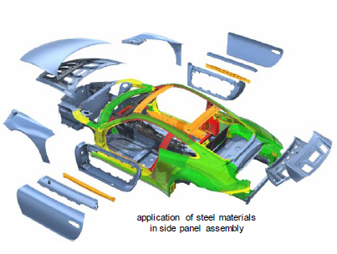
Motivation and objective
Motivation
CO₂ limit value curve is planned for new vehicles
No more than 95 g/km of CO₂ by 2021
Porsche 911 BIW - A mixed construction concept
Objective
To investigate the influence of thermal expansion coefficients of different materials
A vehicle model of Toyota Camry available at GNS mbH, Braunschweig is used
To simulate the adhesive layer damage using FEM software ABAQUSTM
Porsche 911 BIW, Blue – Aluminium / Red, Orange, Yellow and Green – Steel [2]

Slide 10
Contents
Introduction
Industrial process and problem description
Motivation and objective
Overview of material properties
Workflow of the simulation
Results
Conclusion and future work

Slide 11
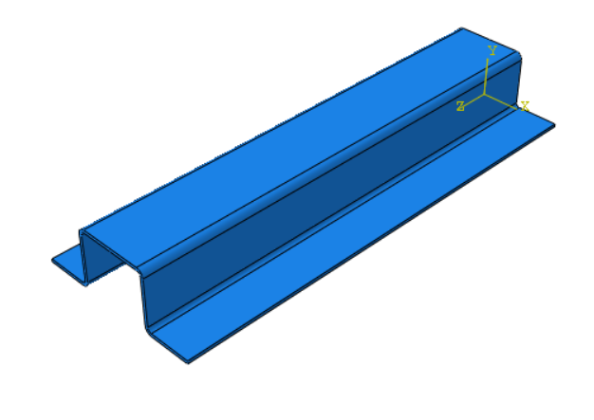
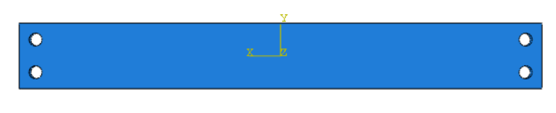
Overview of material properties
Steel
Aluminium
Spot weld
Adhesive
Material properties needed
Thermal properties
ρ, k, c
☑
Film coefficient
☒
Steel hatprofile
E, ν, α, ε_{p}
☑
Mechanical properties
Damage model for adhesive
Aluminium plate
☑

Slide 12
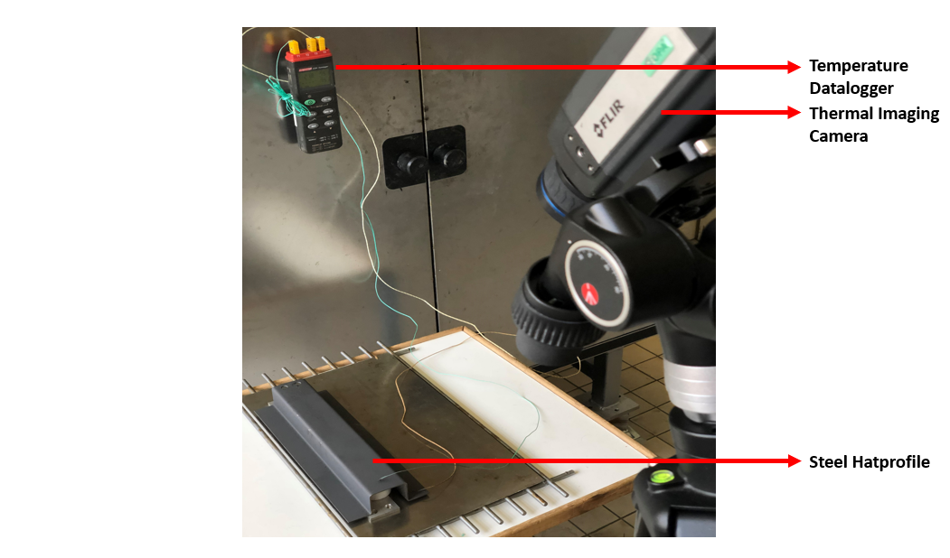
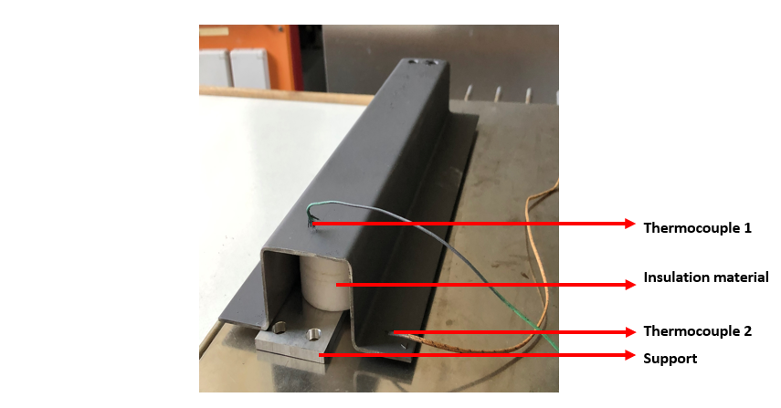
Validation of film coefficient
DC01 Steel hatprofile
Experimental setup of cooling process
DC01 Steel hatprofile
Experiment | Room temperature [°C]
Experiment 1 | 23
Experiment 2 | 20.5
Experiment 3 | 18
Room temperatures of the experiments conducted

Slide 13
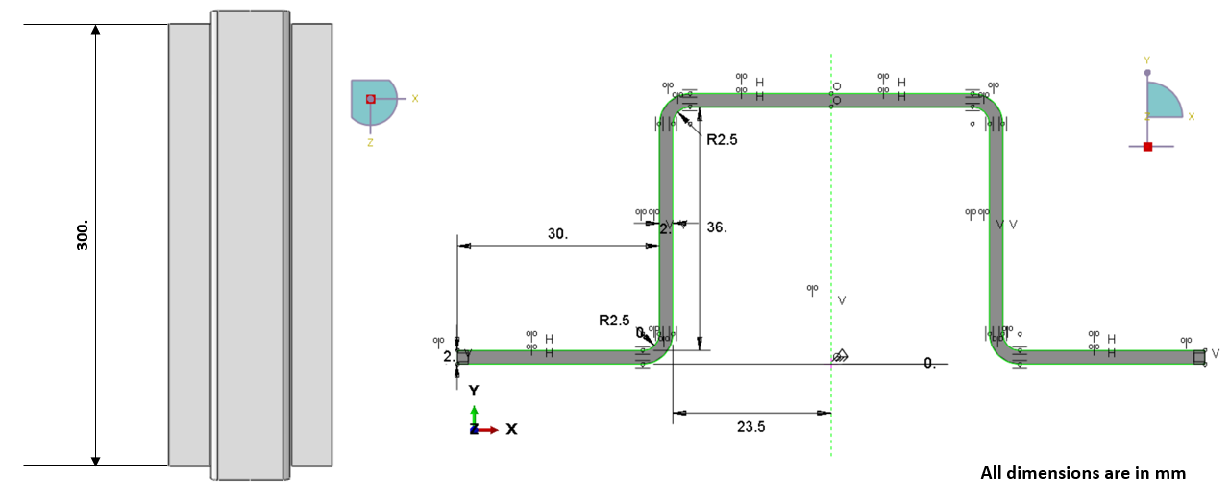
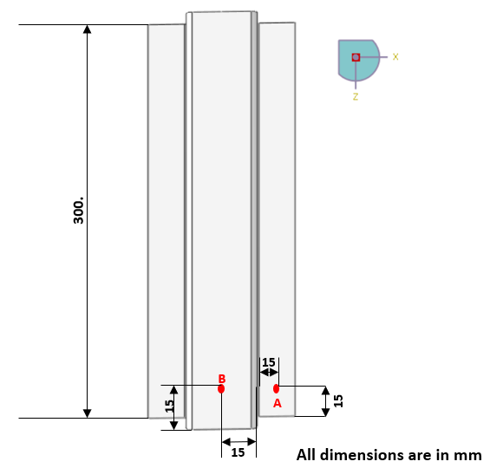
Validation of film coefficient
Steel hatprofile ABAQUS TM model
Dimension of Steel hatprofile FE model
Temperature measurement points
Property | Symbol | Unit | Steel
Density | ρ | ton mm⁻³ | 7.85e⁻⁹
Thermal conductivity | k | mW mm⁻¹K ⁻¹ | 52
Specific heat capacity | c | mJ ton⁻¹K ⁻¹ | 0.48e⁹
Thermal properties used for DC01 Steel simulation

Slide 14
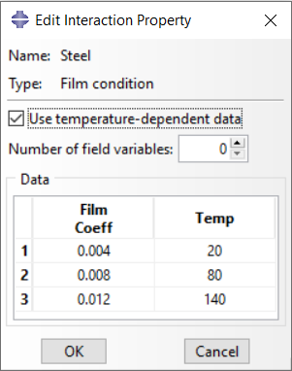
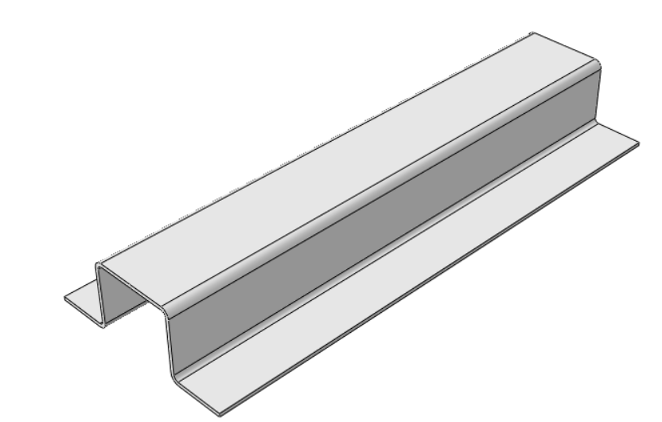
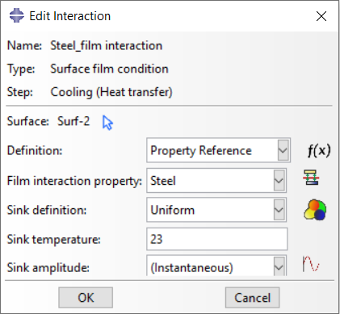
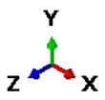
Validation of film coefficient
Steel hatprofile ABAQUS TM model – Thermal analysis
23°C – Sink temperature
180°C – Initial condition
Thermal analysis of Steel hatprofile

Slide 15
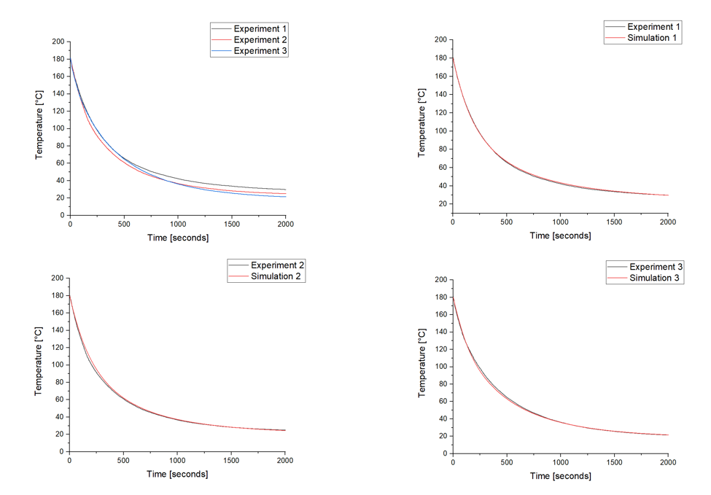
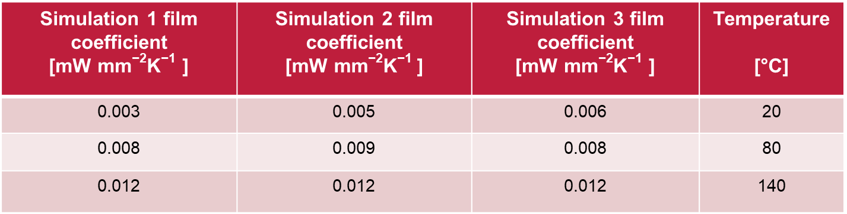
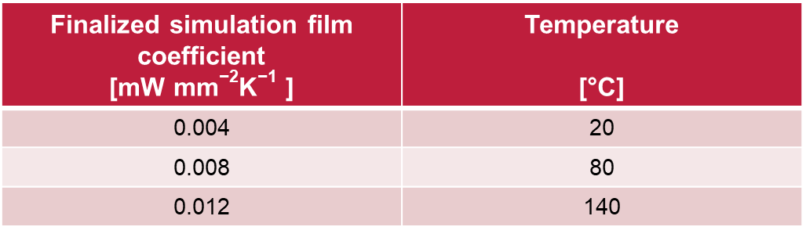
Validation of film coefficient
Experiment vs Simulation curves
Temperature-dependent film coefficients obtained from FE simulations
Temperature-dependent film coefficients finalized for Steel material
Experiment vs simulation cooling rate of DC01 Steel hatprofile

Slide 16
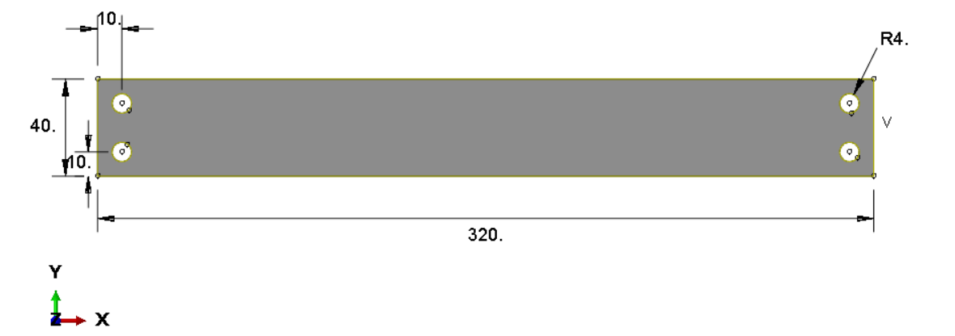
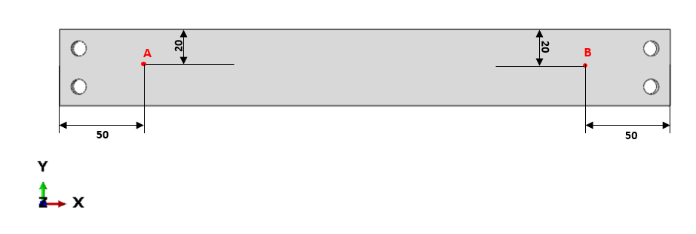
Validation of film coefficient
Aluminium plate ABAQUS TM model
All dimensions are in mm
All dimensions are in mm
Dimension of Aluminium plate FE model
Temperature measurement points
Property | Symbol | Unit | Aluminium
Density | ρ | ton mm⁻³ | 2.71e⁻⁹
Thermal conductivity | k | mW mm⁻¹K ⁻¹ | 237
Specific heat capacity | c | mJ ton⁻¹K ⁻¹ | 0.91e⁹
Thermal properties used for EN-AW-6082 Aluminium simulation

Slide 17
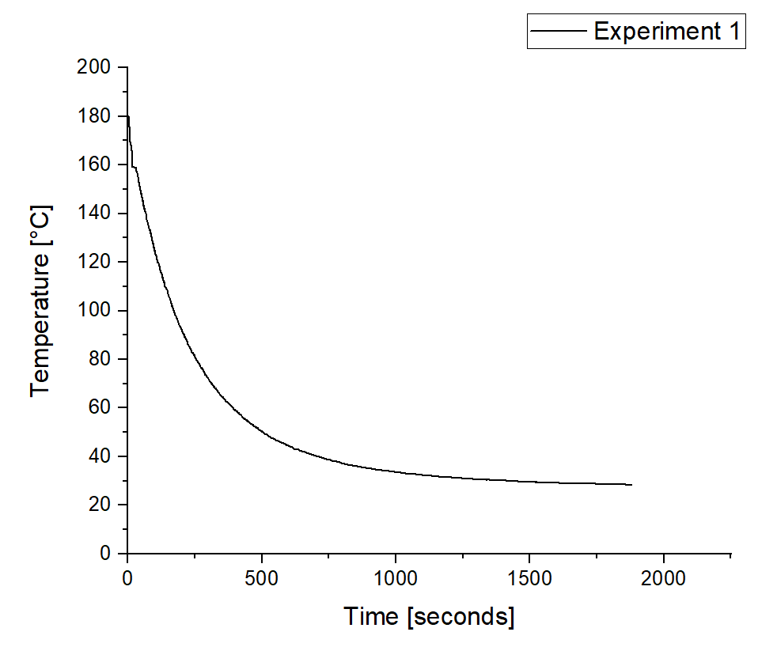
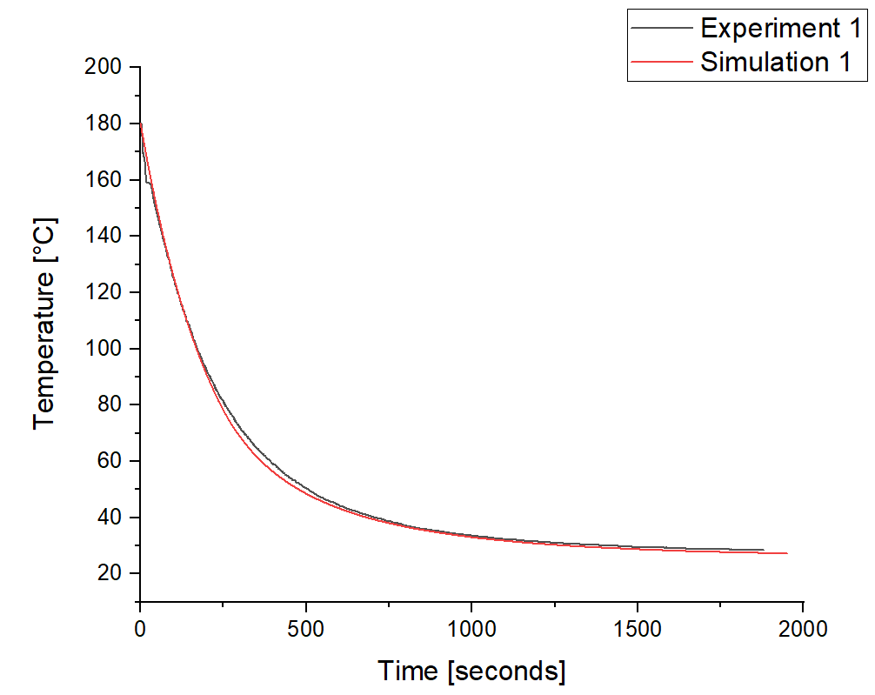
Validation of film coefficient
Room temperature : 26°C
Experiment vs simulation cooling rate of EN-AW-6082 Aluminium plate
Finalized simulation film coefficient [mW mm⁻²K⁻¹ ] | Temperature [°C]
0.008 | 20
0.023 | 80
Temperature-dependent film coefficients finalized for Aluminium material

Slide 18
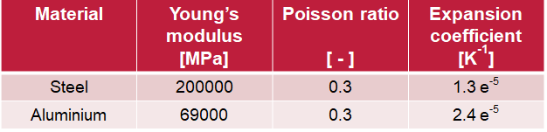
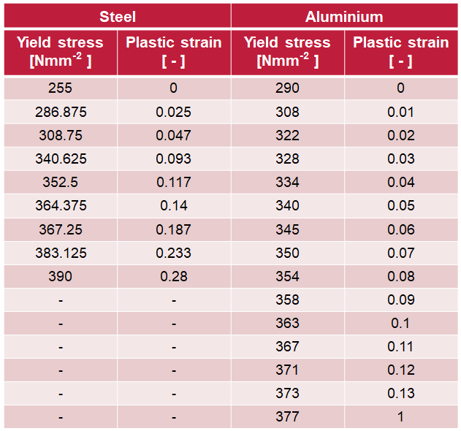
Mechanical properties
Steel and Aluminium
Validated with data according to
DIN EN ISO 527

Slide 19
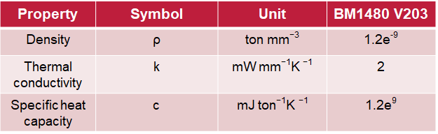
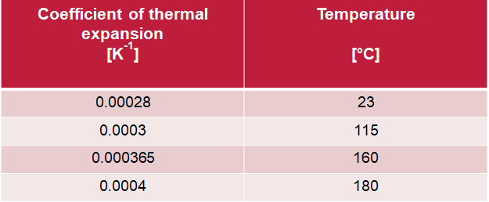
Mechanical properties
Spot weld
Thermal expansion coefficient of spot weld – 0.0004 per Kelvin
Adhesive
One component heat curing epoxy- based
BETAMATETM 1480V203
Thermal properties used for BM1480 V203 adhesive
Temperature-dependent thermal expansion coefficient used for BM1480 V203 adhesive

Slide 20
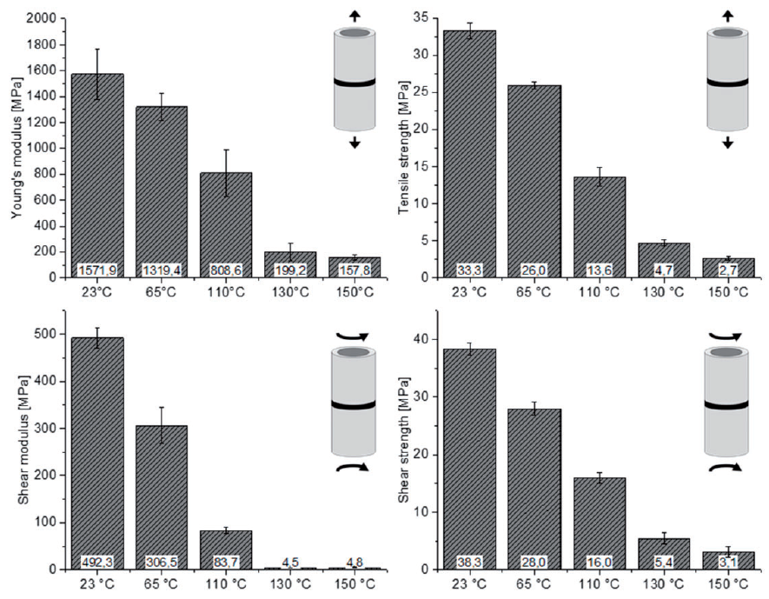
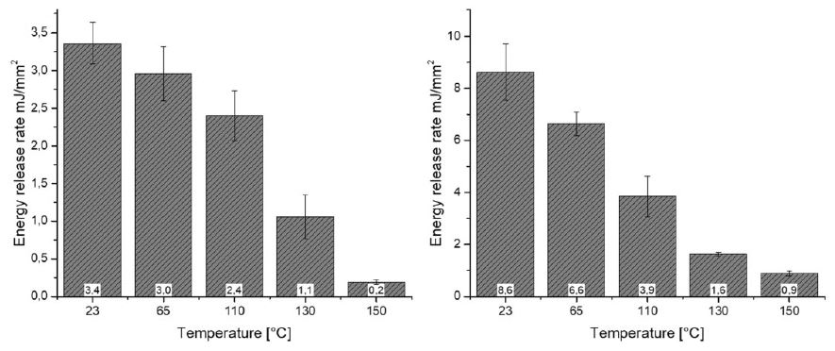
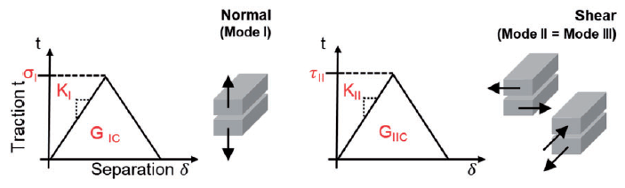
Mechanical properties
Damage model of adhesive in ABAQUSTM
Energy release rates [5]
Strength and stiffness parameters [5]
Mechanical parameters of a bilinear traction separation law [5]

Slide 21
Contents
Introduction
Industrial process and problem description
Motivation and objective
Overview of material properties
Workflow of the simulation
Results
Conclusion and future work

Slide 22
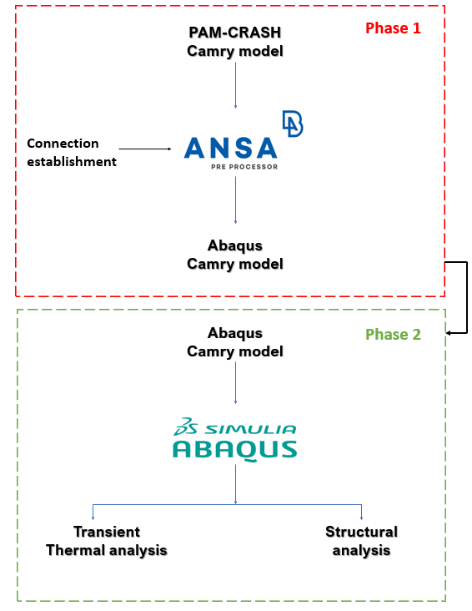
Workflow of the simulation
Phase 1:
Preprocessing the model
Material data checks
Establishing FE representation of spot weld connections
Surface SET creation
Phase 2:
Importing the model
Creating necessary BC’s
Transient thermal analysis
Subsequent structural analysis
Workflow of the simulation of cooling process

Slide 23
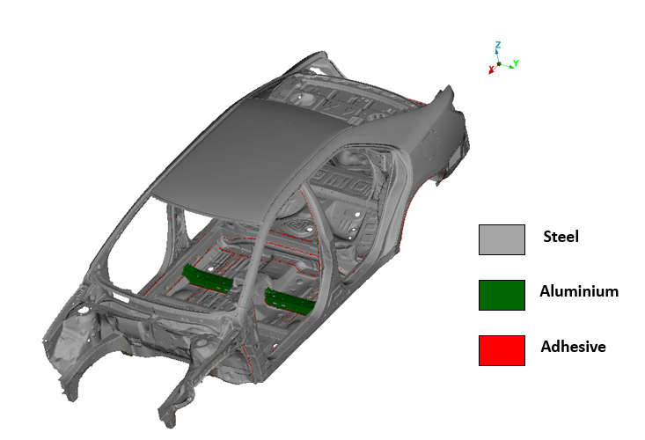
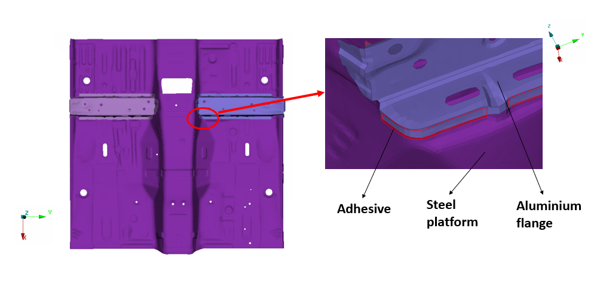
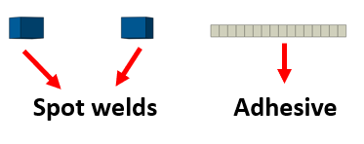
Workflow in ANSATM pre-processor
Toyota Camry model
Aluminium flanges adhesively bonded to the steel platform
Aluminium parts in the entire car model
PAM-CRASH version to ABAQUS version
Adhesive damage results can be used in the crash simulation
Hybrid joined aluminium panel floor members on a steel platform
Around 5000 (approx.) spot welds and few adhesive connections

Slide 24
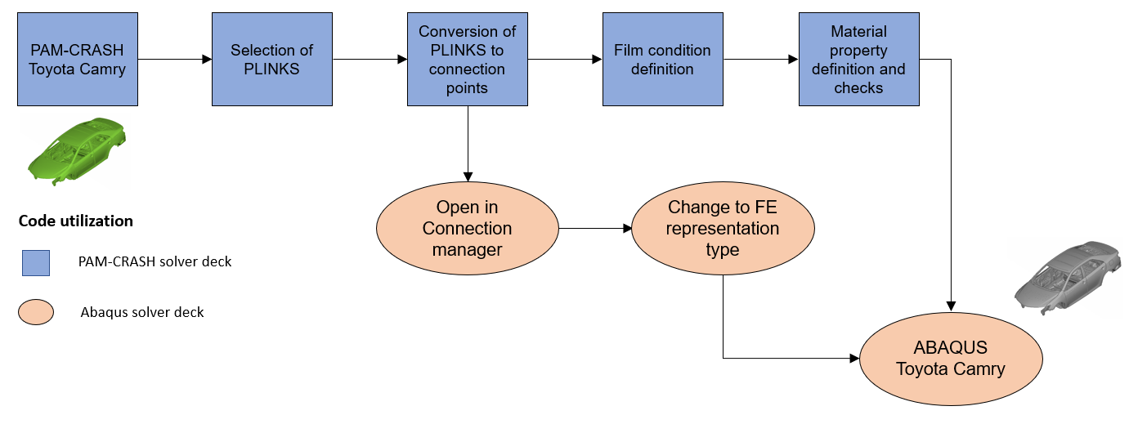
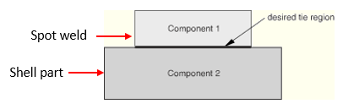
Workflow in ANSATM pre-processor
Preprocessing procedure
Process flowchart for pre-processing
Connection entities | PAM-CRASH | ABAQUS
Spot weld | PLINKS | DYNA spot weld
Finite element representations of the connection entities
Example of two components to be tied together [6]

Slide 25
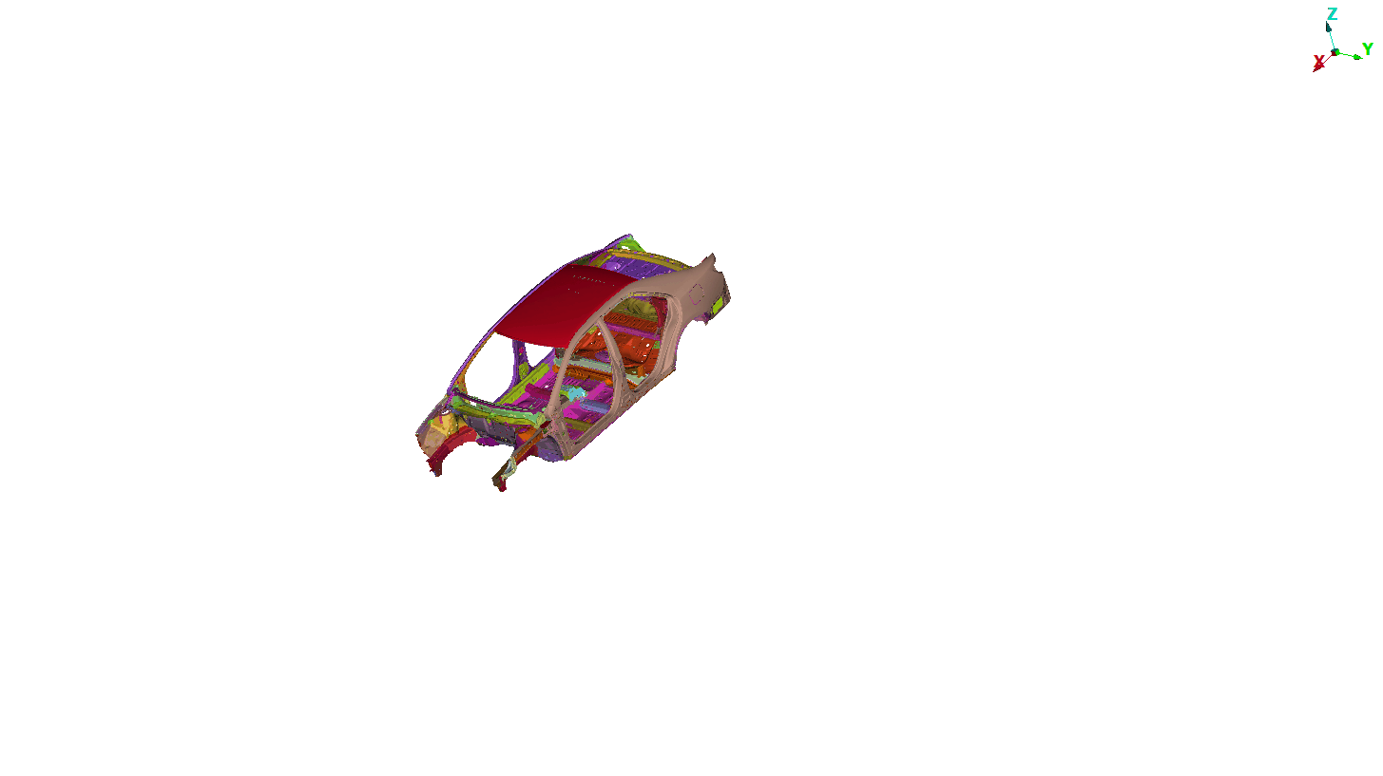
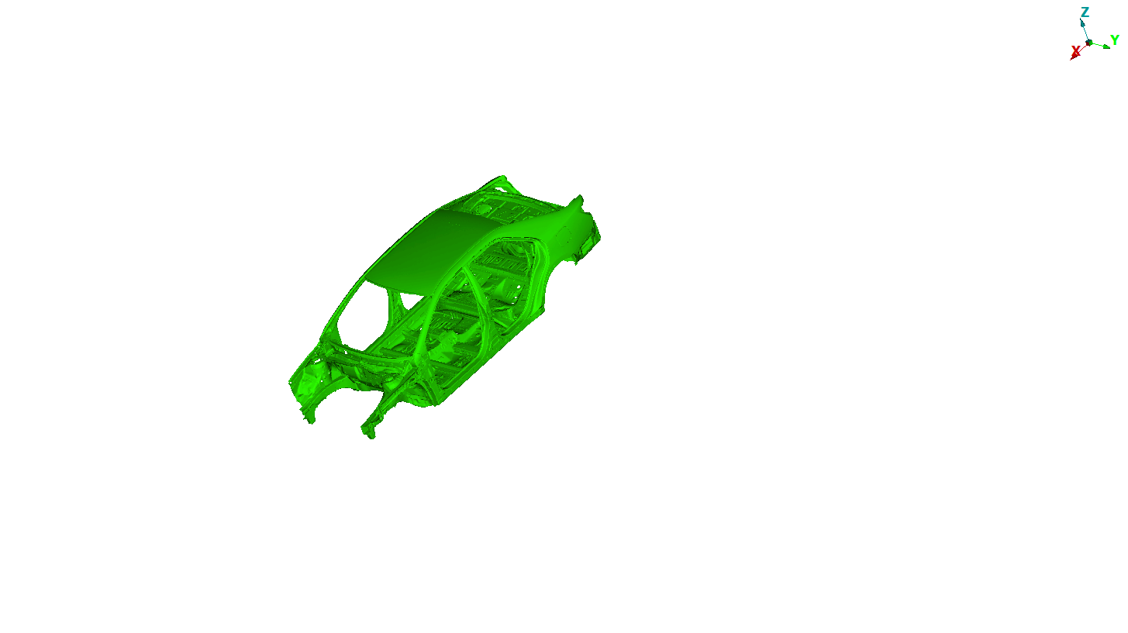
Workflow in ABAQUSTM
Sequentially coupled thermal stress analysis
Two fields has to be determined in thermo-mechanical analysis
One field influences the other or both can influence each other
Load
Temperature
Displacement
Can be solved by uncoupled heat transfer and then a displacement/stress analysis
In this problem, temperature does not depend on stress analysis
This is a common example of sequential multiphysics workflow

Slide 26
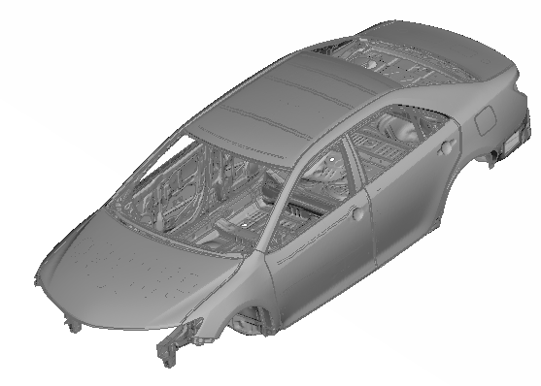
Thermal-stress analysis in ABAQUSTM
Thermal
Simulation procedure in ABAQUSTM
Mechanical
Part
Property
ρ, k, c
E, ν, α, ε_{p}
Heat transfer
2400 seconds
Static, general
2400 seconds
Step
Interaction
1. Film condition
2. Suppress MPC
Redefine MPC
Initial condition
180°C
Nodal temp results
Load
DS4, DS3, DC3D8
S4R, S3, C3D8, COH3D8
Mesh
Job
Thermal analysis results
Displacement, SDEG

Slide 27
Contents
Introduction
Industrial process and problem description
Motivation and objective
Overview of material properties
Workflow of the simulation
Results
Conclusion and future work

Slide 28
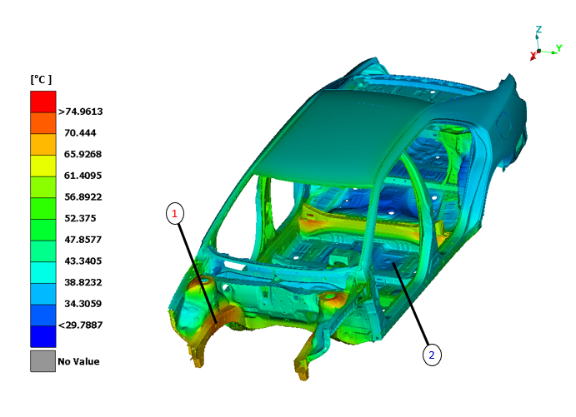
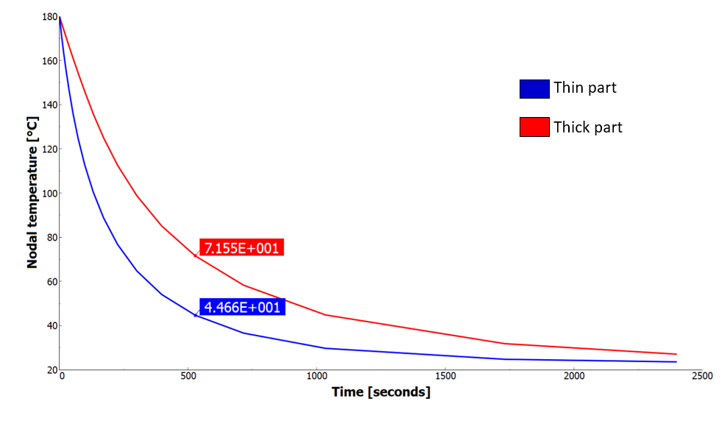
Results
Temperature distribution during cooling process
1
2
Temperature distribution after 527 seconds
Temperature difference between thin and thick shell parts
1
Right midrail – (Thickness: 2.628mm)
2
Steel platform – (Thickness: 0.75mm)
Temperature distribution is inhomogenous
Variation in thickness of the components and geometry

Slide 29


Results
Temperature variation of components connected by spot weld
Measurement point to illustrate temperature variation
Temperature difference of upper rail rear and upper rail top
Upper rail top and rear parts are investigated
Mild difference of about 1°C
Reasonable and precisely accurate

Slide 30

Results
Overall displacement during cooling process
Maximum displacement is found in the roof cross members
Body has less than 4mm displacement overall

Slide 31


Results
Displacement of steel platform during cooling
Displacement in X-direction
Displacement in Z-direction
Entire vehicle starts to contract during cooling
Displacement along x-direction leads to buckling of floor front
A peak value of 2mm displacement along the transverse direction
Thickness of the components

Slide 32



Results
Deformation of the aluminium flange
Scaled by a factor of 20
Element deletion based upon damage
Maximum degradation is 1
Crossing of adhesives leads to the maximum degradation
Scaled by a factor of 15

Slide 33

Results
Stiffness degradation of adhesive in other regions
SDEG of adhesive in B-pillar
SDEG of adhesive in rear outer panel
No degradation in the spot weld regions within adhesive in B-pillar
Minimal stiffness degradation in the adhesive connecting floor trunk

Slide 34
Contents
Introduction
Industrial process and problem description
Motivation and objective
Overview of material properties
Workflow of the simulation
Results
Conclusion and future work

Slide 35
Conclusion and scope for future work
Conclusion
A method has been identified for simulation
Offers possibility of heat transfer through spot welds in thermal analysis
A process history of the behavior of adhesive can be established
The critical spots of the BIW structure can be determined
Future work
An experimental verification of the adhesively bonded BIW structure numerically calculated in this work is desirable
Long running time of mechanical simulation should be investigated

Slide 36
Thank you for your attention

Slide 37
References
https://www.linkedin.com/pulse/body-white-biw-design-fundamentals-part1-mahm%C3%BCd-hosseinjani
Robert Georg Dietrich. Analyse der Wärmeausdehnungs-Inkompatibilität bei
Klebverbindungen aus CFK, Stahl und Aluminium bei der Fertigung einer lackierten Karosserie (2017). PhD thesis, Technische Universität München, Germany.
Numerische abschätzung von eigenspannungen und bauteilverformungen in gesamtfahrzeugmodellen beim kleben im karosseriebau. Paderborner Symposium Fügetechnik (2006).
https://www.theseus-fe.com/ths_content/publications/slides/20061129_slides_kleben-im-karosseriebau_prozess-simulation_de.pdf
Theseus FE.
https://www.theseus-fe.com/simulation-software/paint-dryer-simulation

Slide 38
References
5. Niklas Günther, Michael Griese, Elisabeth Stammen, and Klaus Dilger.(2018) Modeling of adhesive layers with temperature-dependent cohesive zone elements for predicting adhesive failure during the drying process of cathodic dip painting.
6. ABAQUS manual V6.6 https://classes.engineering.wustl.edu/2009/spring/mase5513/abaqus/docs/v6.6/books/usb/default.htm?startat=pt08ch28s03aus107.html#usb-cni-ptiedconstraint

